Slide 1
Driver Drowsiness Detection System
Mid project presentation

Slide 2
Why do we need?
“Driver Drowsiness Detection is a vehicle safety technology to help prevent accidents caused by
driver drowsiness”
National Highway Traffic Safety Administration – one million crashes involve drowsy driving a year (NSC)
AAA Foundation for Traffic Safety – 328,000 drowsy crashes every year (NSC)
Lack of a real time monitoring system costs precious lives, costs $109 billions (NSC)
Effective utilization of valuable resources
Safety, comfort and confidence
Notes:
Give examples of inspecting driver before (s)he takes over but during journey gets tired due to physical or mental disturbances. So is the need for continuous monitoring in place.
Save Government precious resources such as money, time, police, rescue team, infrastructure, etc. Insurance companies can use funds to natural calamities, or on unforeseen incidents rather than human mistakes
Motor vehicle operators can assure safety, comfort and confidence to passengers
Give examples of inspecting driver before (s)he takes over but during journey gets tired due to physical or mental disturbances. So is the need for continuous monitoring in place.
Save Government precious resources such as money, time, police, rescue team, infrastructure, etc. Insurance companies can use funds to natural calamities, or on unforeseen incidents rather than human mistakes
Motor vehicle operators can assure safety, comfort and confidence to passengers

Slide 3
Why do we need?
Solutions include
- Steering pattern monitoring
Monitors power steering
Exception - Automatic lane-keeping system
- Vehicle position lane monitoring
Uses lane monitor camera
Exception – Automatic lane-keeping system
Physiological measurement
Employs body sensors to measure brain activity, heart rate, muscle activity, etc.
Relatively expensive
Driver face monitoring
Monitors driver face using computer vision with camera
Simple and affordable
Notes:
Give examples of inspecting driver before (s)he takes over but during journey gets tired due to physical or mental disturbances. So is the need for continuous monitoring in place.
Save Government precious resources such as money, time, police, rescue team, infrastructure, etc. Insurance companies can use funds to natural calamities, or on unforeseen incidents rather than human mistakes
Motor vehicle operators can assure safety, comfort and confidence to passengers

Slide 4
Current Systems in use
Audi – Rest recommendation system
BMW – Active driving assistant
Bosch – Driver drowsiness detection
Ford – Driver alert
Honda – Driver attention monitor
Hyundai – Driver attention alert
Jaguar – Driver fatigue alert

Slide 5
Why did we pick present solution ?
A system works and continues to work smooth only when it is monitored continuously, and effective, corrective measures take place in time
Studies have shown strong correlation between fatigue and facial expressions and monitoring facial expression is a widely accepted method for detection driver drowsiness.
Drowsy Driving Prevention Week is Nov. 1-8, 2020 (https://www.nsc.org/road-safety/safety-topics/fatigued-driving)

Slide 6
Project objectives
Detecting fatigue and drowsiness levels
Study the requirements of problem
Research solutions, merits and demerits
Analyze feasibility and applicability
Prepare a cost-effective fool proof driver alert system

Slide 7
Project scope
Functionality scope
Affordable by all vehicles
Automatic reporting to vehicle operators
Avoid major catastrophe
Technical scope
Supervised / Unsupervised
Machine learning / Deep Learning
Hybrid machine learning / Ensemble approach
Intelligent systems / Sense making systems
Notes:
Several solutions exist. Majority are employed in luxury vehicles. Life is precious and not to be scaled based on money alone. Who knows the poor guy travelling in a passenger vehicle is not Einstein?
In case, the driver is less fatigue and controls - even then the reports can be captured appropriate safety precautions can be taken by the operators in time.
In case, the driver is in helpless state – advance sensor controls can rescue by leaving the vehicle to a stable state keeping the circumstances in view.
- at least can alert passengers inside so that they can take appropriate measures (if such costly equipment is not administered)

Slide 8
Data resource required
Images of face with open and closed states of left and right eyes
Eye image data bank: | Attributes
http://mrl.cs.vsb.cz/eyedataset | Subject | Identifies subject
 | Image | Identifies image
 | Gender | Man / Woman
 | Spectacles | Wears or not glasses
 | Reflections | No / small / big reflections
 | Lighting conditions | Good / Bad light condition
 | Device sensor | Sensor captured image
 | Eye state | Closed / Open state of Eye

Slide 9
Data resources
Images of face with open and closed states of left and right eyes
The eye image data bank
http://mrl.cs.vsb.cz/eyedataset

Slide 10
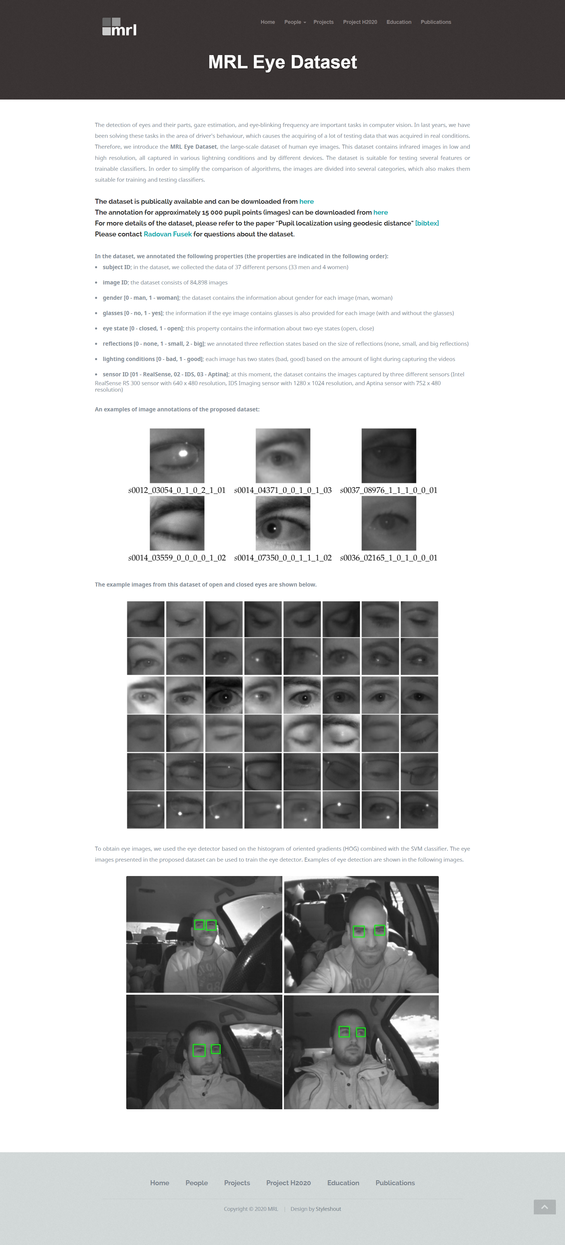
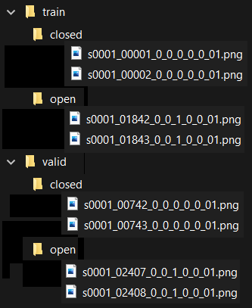
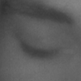
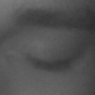
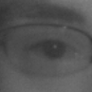
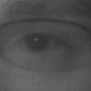
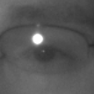
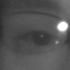
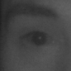
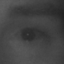


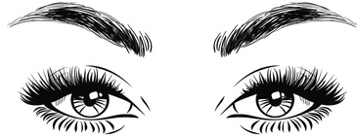

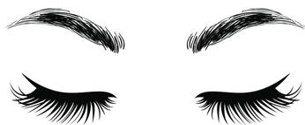
Bird eye view
Training Data
Validation Data
http://mrl.cs.vsb.cz/eyedataset
Image collection
Image Acquisition
Folder Structure
Feature Extraction
Knowledge
Open
Closed
Image Acquisition
Feature Extraction
Matching

Slide 11
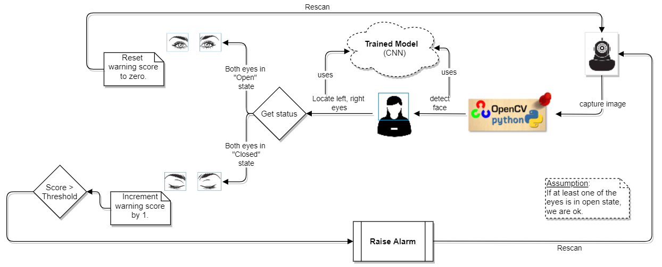
Detailed look at the model

Slide 12


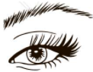
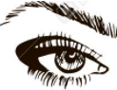


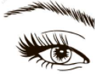



Another view
Read Image
Collect eye
images
Train
Get optimal weights
Deep Learning
Predict eye status
Open
Closed

Slide 13







Haar features to detect face features like eye, nose, mouth, etc.
Original
Haar like features
Haar features are named after Alfred Haar,
a Hungarian mathematician.
Viola and Jones have defined several Haar like features to
detect facial parts from an image.
For example,
can detect eye-brows of a person.
can detect nose portion of a person.
Edge Features
Line Features
Extended
Haar like features
Center Surround Features
Etc.

Slide 14
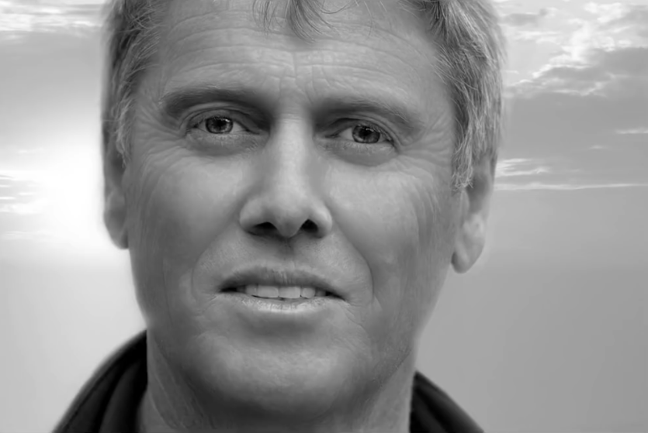

Facial feature detection technique
The gray scale image will have pixel values ranging from 0 through 255.
This haar cascade classifier detects darker eye-brows and lighter
forehead.
This haar cascade classifier detects lighter nose and darker
side regions.
This haar cascade classifier detects darker upper and lower
lips differentiating brighter teeth region.
https://www.youtube.com/watch?v=F5rysk51txQ&ab_channel=GlobalSoftwareSupport

Slide 15

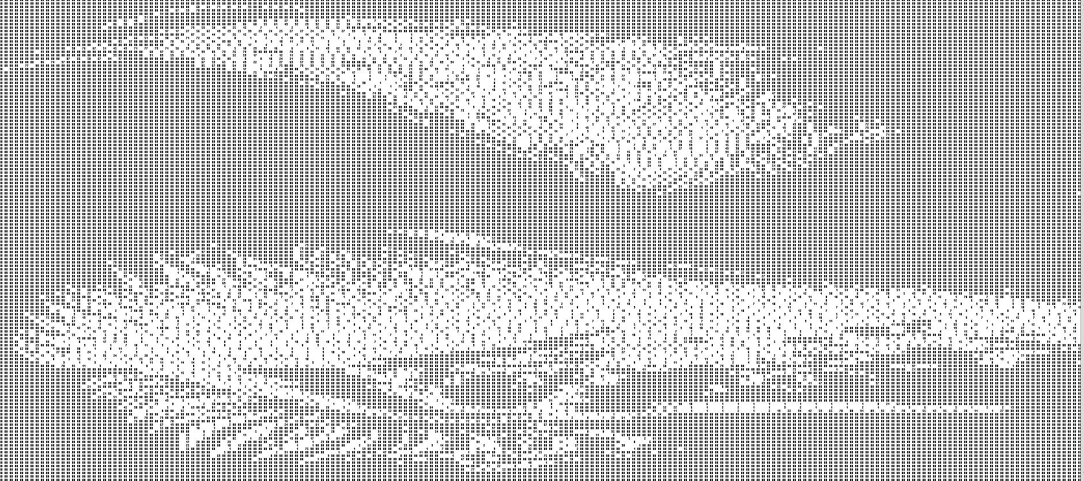
A portion of graphic gray color image with intensity values in numeric form
255 | 254 | 255 | 255 | 255 | 255 | 255 | 255 | 255 | 255 | 255 | 255 | 255
255 | 255 | 255 | 255 | 255 | 255 | 255 | 255 | 255 | 255 | 255 | 255 | 255
255 | 255 | 255 | 255 | 255 | 255 | 255 | 255 | 255 | 255 | 255 | 255 | 255
254 | 255 | 255 | 255 | 255 | 255 | 255 | 255 | 255 | 255 | 255 | 255 | 255
255 | 250 | 253 | 255 | 251 | 255 | 254 | 253 | 255 | 255 | 255 | 253 | 255
54 |  | 88 | 135 | 187 | 243 | 253 | 255 | 253 | 253 | 253 | 252 | 253
 | 0 |  |  | 0 |  | 22 |  | 91 | 154 | 219 | 252 | 254
47 |  |  | 1 |  |  | 0 |  |  | 6 |  | 52 | 141
211 | 148 |  | 76 |  | 13 |  |  | 0 |  | 15 | 101 | 195
248 | 252 | 255 | 254 | 255 | 230 | 156 |  | 52 |  |  | 0
254 | 252 | 255 | 248 | 252 | 249 | 255 | 230 | 220 | 203 | 107 |  | 14
130 | 167 | 236 |  | 68 | 245 | 255 | 252 | 255 | 253 | 255 | 245 | 141
149 | 252 | 122 | 131 | 247 |  | 41 | 242 | 255 | 253 | 255 | 249 | 255
251 | 255 | 110 | 158 | 255 | 124 |  | 97 | 238 |  | 35 | 239 | 254
27 |  | 73 | 253 | 249 |  | 44 | 182 | 255 | 129 |  | 67 | 212

Slide 16
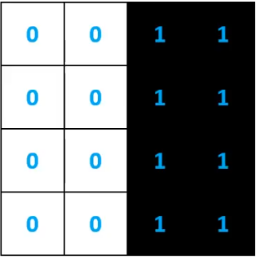

How are we using Haar features?
Let us see how it is going to work taking a small nose portion of the image.
Ideal Haar feature pixel intensities
0: white
1: black
Real intensity values of nose portion
0.9 | 0.2 | 0.1 | 0.1 | 0.1 | 0.2 | 0.3 | 0.9
0.8 | 0.2 | 0.1 | 0.1 | 0.1 | 0.2 | 0.3 | 0.8
0.6 | 0.1 | 0.1 | 0.1 | 0.1 | 0.1 | 0.2 | 0.6
0.6 | 0.1 | 0.2 | 0.2 | 0.2 | 0.1 | 0.1 | 0.6
0.6 | 0.1 | 0.2 | 0.2 | 0.2 | 0.1 | 0.1 | 0.6
0.6 | 0.1 | 0.2 | 0.2 | 0.2 | 0.1 | 0.1 | 0.6
0.6 | 0.1 | 0.2 | 0.2 | 0.2 | 0.1 | 0.1 | 0.6
0.6 | 0.1 | 0.2 | 0.2 | 0.2 | 0.1 | 0.1 | 0.6
That’s lot of computations. Is there a way we can reduce ?

Slide 17
Simplification through Integral summation
As we saw in previous slide, for various image sizes, we need to compute the sums. Viola – Jones have found a simple technique using which we can compute sum of any co-ordinate (x, y) with just 4 values.
Let us explain this with an example:
1 | 1 | 1
1 | 1 | 1
1 | 1 | 1
1 | 2 | 3
2 | 4 | 6
3 | 6 | 9
Input Image
Integral sums

Slide 18
Viola – Jones simplification of Summation to just 4 value addition
The simplification reduces the huge number of calculations drastically.
Original Image
Integral Image
0.9 | 0.2 | 0.1 | 0.1 | 0.1 | 0.2 | 0.3 | 0.9
0.8 | 0.2 | 0.1 | 0.1 | 0.1 | 0.2 | 0.3 | 0.8
0.6 | 0.1 | 0.1 | 0.1 | 0.1 | 0.1 | 0.2 | 0.6
0.6 | 0.1 | 0.2 | 0.2 | 0.2 | 0.1 | 0.1 | 0.6
0.6 | 0.1 | 0.2 | 0.2 | 0.2 | 0.1 | 0.1 | 0.6
0.6 | 0.1 | 0.2 | 0.2 | 0.2 | 0.1 | 0.1 | 0.6
0.6 | 0.1 | 0.2 | 0.2 | 0.2 | 0.1 | 0.1 | 0.6
0.6 | 0.1 | 0.2 | 0.2 | 0.2 | 0.1 | 0.1 | 0.6
0.9 | 1.1 | 1.2 | 1.3 | 1.4 | 1.6 | 1.9 | 2.8
0.8 | 2.1 | 2.3 | 2.5 | 2.7 | 3.1 | 3.7 | 5.4
2.3 | 2.8 | 3.1 | 3.4 | 3.7 | 4.2 | 5.0 | 7.3
2.9 | 3.5 | 4.0 | 4.5 | 5.0 | 5.6 | 6.5 | 9.4
3.5 | 4.2 | 4.9 | 5.6 | 6.3 | 7.0 | 8.0 | 12
4.1 | 4.9 | 5.8 | 6.7 | 7.6 | 8.4 | 9.5 | 14
4.7 | 5.6 | 6.7 | 7.8 | 8.9 | 9.8 | 11 | 16
5.3 | 6.3 | 7.6 | 8.9 | 10 | 11 | 13 | 18
0 | 0 | 1 | 1
0 | 0 | 1 | 1
0 | 0 | 1 | 1
0 | 0 | 1 | 1
1.1
1.1 = (8.4 + 2.5) - (6.7 + 3.1)
Source - https://www.youtube.com/watch?v=p9vq90NYHMs&ab_channel=YoussefShakrina

Slide 19
Pretend 3 Haar like features to capture eyes, nose, mouth.
Note:
(For simplicity, we are showing image scanning with fixed filter size but in reality it will be done at multiple scales.)
Let us watch the algorithm visually
A
No Match!
Found Match!

Slide 20
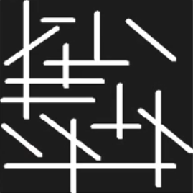
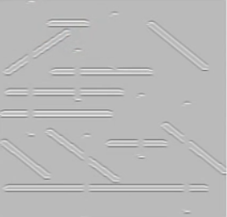
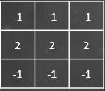
Edge detection Filter technique to highlight horizontal and angled lines and lower importance of vertical lines

Slide 21
Pretend 3 Haar like features to capture eyes, nose, mouth.
Let us watch the algorithm visually
A
No Match! Scan next one.
Found Match!

Slide 22
Let us watch how the first kernel (haar like edge detection) slides
Let us watch the second kernel (haar like edge detection) slides

Slide 23



Let us see how pattern matching works
Our task is to compare an image with a Haar like image as shown below:
Image intensities
Haar like Image
Image intensities
.1 | .1 | .1 | .1
.1 | .1 | .1 | .1
.9 | .9 | .9 | .9
.9 | .9 | .9 | .9
0 | 0 | 0 | 0
1 | 1 | 1 | 1
.9 | .1 | .9 | .1
.1 | .9 | .1 | .9
.9 | .1 | .9 | .1
.1 | .9 | .1 | .9
Sum of dark pixels – Sum of bright pixels
= 4 – 0 = 4 / 4 = 1
(Sum of dark pixels ~ Sum of bright pixels)/8
= (7.2 – .8) / 8 = 6.4 / 8 = 0.8
(Sum of dark pixels ~ Sum of bright pixels)/8
= (4 – 4) / 8 = 0 / 8 = 0
i.e. the image matches by 80%
i.e. the image doesn’t match with the pattern.

Slide 24
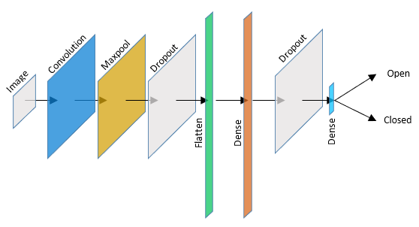
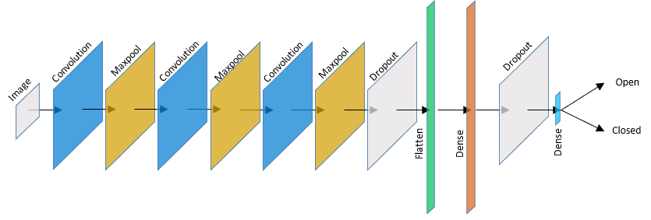
Our Approach
A neural network model with no hidden layer can represent a linear function or decision.
A feedforward network with a single layer is sufficient to represent any function, but the layer may be infeasibly large and may fail to learn and generalize correctly.
— Ian Goodfellow, DLB
So, we’ve decided to create two models:
first model with a pair of Convolution and MaxPool layers
second model with three pairs of Convolution and MaxPool layers
Common layers:
Dropout to prevent overfitting
Flatten layer to step down dimensions
Dense for Full connectivity
Study if increase of layers would have any impact in accuracy.
Model - I
Model - II

Slide 25
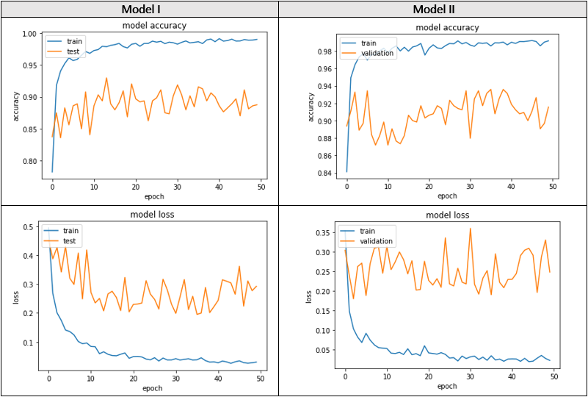
Results of running models
Addition of two more pairs of Convolution and MaxPool layers has no remarkable improvement in performance. It has tripled the execution time.
We could satisfy and stop with Epochs = 15

Slide 26
Other techniques that boost the algorithm
The algorithm discards the sub images of the given image soon after it finds none of the patterns
i.e. with low probabilities or matching quotient.
It assembles several weak classifiers to become a strong classifiers.
In summary, the algorithm works wonders on real world scenarios through effective use of
Integral Summary
Adaboost Ensembling weak classifiers to build a strong classifier
Utilization of Haar like features

Slide 27




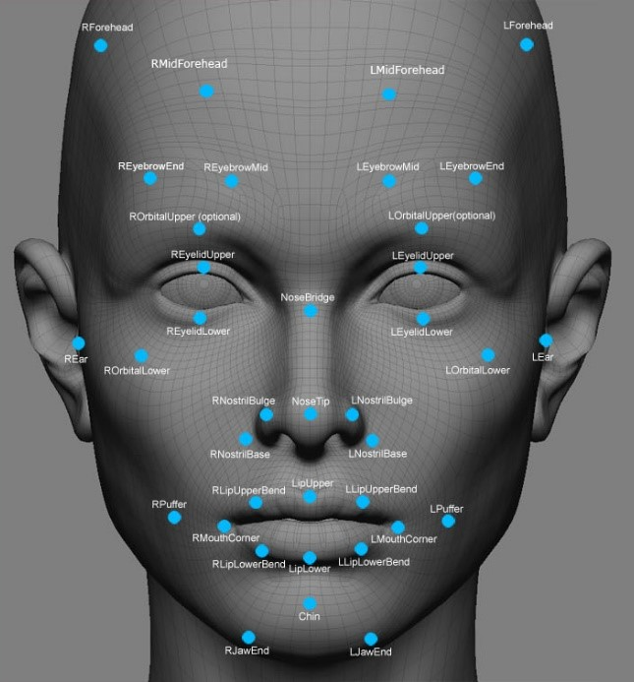






Extensions
Given appropriate training data, the model can be extended to capture not only the status of eyes but also the feelings.
Source - https://www.doc.ic.ac.uk/~jam414/AffectiveComputing/anmol.html

Slide 28
Accomplishments
Survey of various techniques employed in real world
Study on capturing video, image processing using OpenCV
Applied knowledge gained from Singapore National University lectures
References
https://www.superdatascience.com/blogs/opencv-face-detection
https://machinelearningmastery.com/how-to-perform-face-detection-with-classical-and-deep-learning-methods-in-python-with-keras/
https://towardsdatascience.com/real-time-face-recognition-an-end-to-end-project-b738bb0f7348
https://docs.opencv.org/3.4/db/d28/tutorial_cascade_classifier.html
Data set - http://mrl.cs.vsb.cz/eyedataset

Slide 29
Limitations & Improvements
Limitation – Assumes driver wears transparent glasses (not dark glasses obstructing structure of eye)
No matter how many advances, precautions we take we also know how to brake. After all we human intellectuals make and break!
Future Scope
Driver obstructing the monitoring system
Address eye blink rate
Yawning
Missing turns or exits
Addressing low light conditions
Address reflections
Notes:
Each person may have different blink rates, so system can be trained to capture and predict accordingly.
Device capturing images of drivers’ face wearing spectacles may have reflections; system can be trained considering such images to address such conditions

Slide 30

Thank you
Singapore National University
Professors for imparting knowledge
Administrative staff

Slide 31
Questions and Comments

